Slide 1

Automatic Exam Marks Filling using xlwings Enhanced with Optimized Data Handling Approach
By
G.J.Rajalakshmi
Immek Softech Academy

Slide 2


Project Overview
Automated marks entry using Python xlwings
Direct interaction with Excel sheets
Fast, accurate, and efficient process
Reduces manual effort significantly

Slide 3

Current Challenge Limitations of SQL Queries in Real-Time Web Apps
Frequent SQL queries increase server load
Latency affects user experience
Every page update triggers a new DB call
Overhead grows with the number of users

Slide 4
Proposed Enhancement
Replace live SQL queries with preprocessed data
Use structured Excel/CSV/JSON data instead of repeated DB queries
Organize data by Roll Number
Use Python + xlwings to auto-fill marksheets
Use this data to instantly populate the web page

Slide 5
Tools & Technologies
🐍 Python
📊 Excel
🔗 xlwings library
💻 Jupyter Notebook

Slide 6
Workflow Process
Input student data / marks sheet template
Python script reads input
xlwings connects to Excel
Marks are processed/calculated
Output automatically updated in Excel

Slide 7
Optimized Data Flow
Database / Input File
Convert to CSV/JSON
Roll Number Lookup
Python Processing
Excel Output Generation

Slide 8
Key Features
Automatic data entry
Error reduction
Time-saving
Easy to use
Scalable for large datasets

Slide 9
Benefits
Scalable for thousands of users
Easier to cache and distribute
Faster processing (no repeated queries)
Reduced server/database load
Improved efficiency
Accurate calculations
Scalable for thousands of users Easier to cache and distribute
Easy maintenance

Slide 10
Use Cases
Student result or attendance dashboards
Public-facing data portals
Internal tools with frequent reads but infrequent writes
Offline-friendly web apps

Slide 11
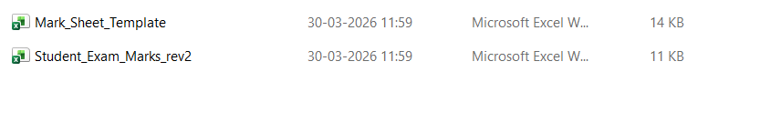
Input Data
Student Exam Marks sheet template/Input data

Slide 12
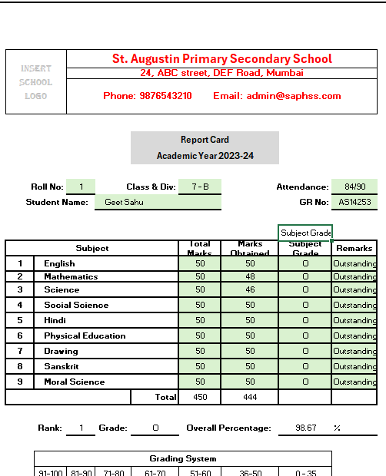
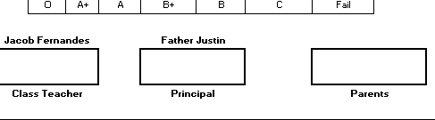
Mark Sheet Template

Slide 13
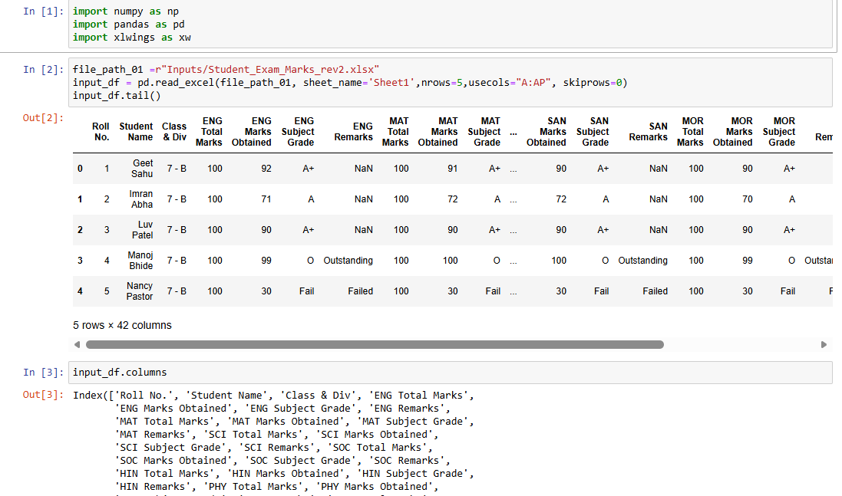
Code Snippet
The below code reads the input data mentioned in the previous slide

Slide 14
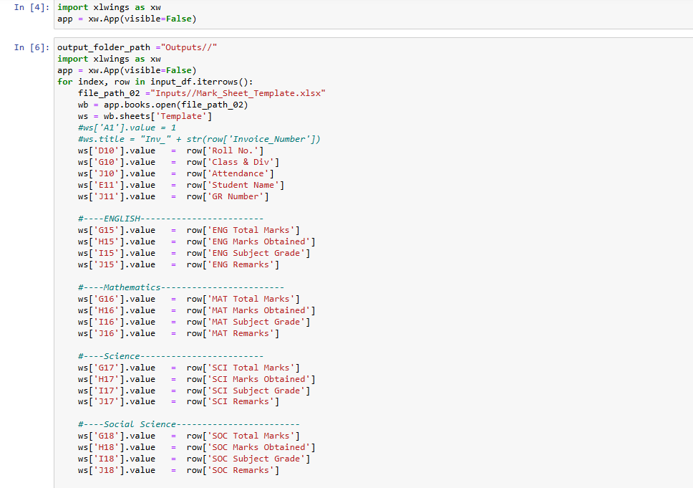
Code Snippet
From the given template,datasets are iterated (input data) and each fields are filled accordingly using the below code snippet and saved in the output folder with separate Roll number.

Slide 15
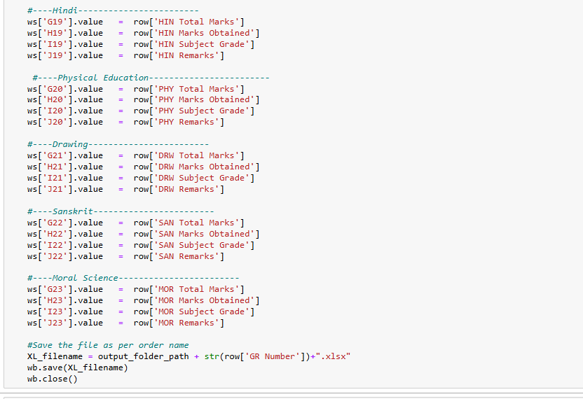
Code Snippet Contd

Slide 16
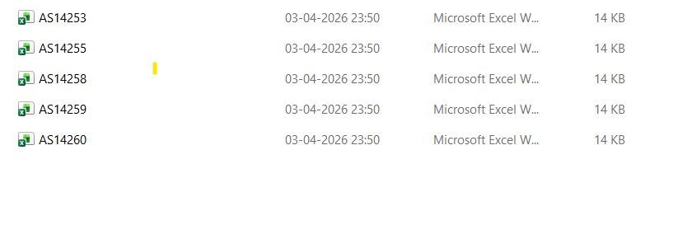
Sample Output
Each excel sheet filled automatically with below details in the mentioned output folder:
Student Name
Subject Marks
Total
Grade

Slide 17
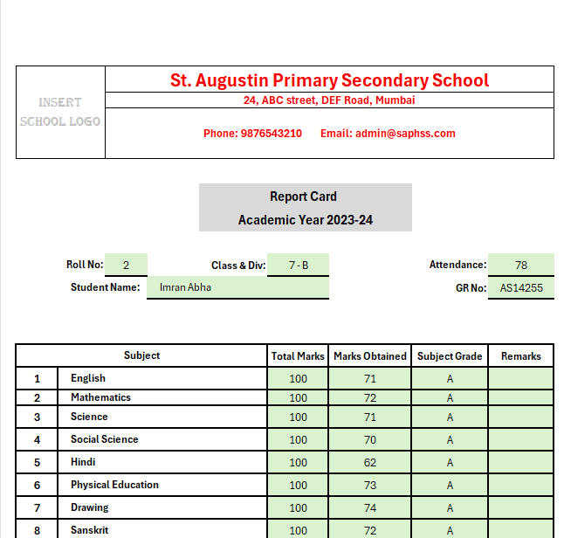
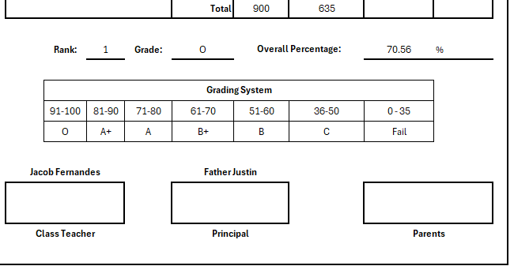
Automated Sample Output

Slide 18
Conclusion
xlwings simplifies Excel automation
Structured data improves performance
Rethink constant querying — use structured data
Frontend-first strategy for performance
Especially effective in student or admin portals
Simple idea
Big performance gains
Smarter Data Access for Faster UX

Slide 19
Thank you

